Slide 1

REST API Fundamentals in Flask

Slide 2
Introduction to REST APIs and CRUD Operations

Slide 3
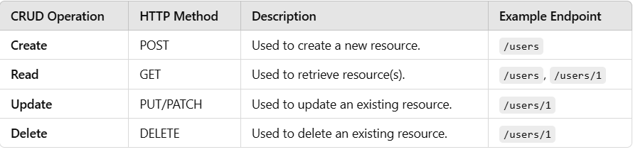
REST APIs and CRUD Operations
REST APIs are stateless and rely on standard HTTP methods to perform operations on resources (e.g., users, posts, products). These methods are usedREST APIs (Representational State Transfer Application Programming Interfaces) are widely used in web development and data science. They are designed to provide a standardized way for applications to communicate with each other over the internet, using HTTP protocols. REST is an architectural style, and an API built according to REST principles is called a RESTful API.
to implement CRUD operations.
CRUD Operations in REST APIs
CRUD stands for Create, Read, Update, and Delete. These are the fundamental operations for managing resources in any application. In the context of REST APIs, these operations are mapped to HTTP methods:

Slide 4
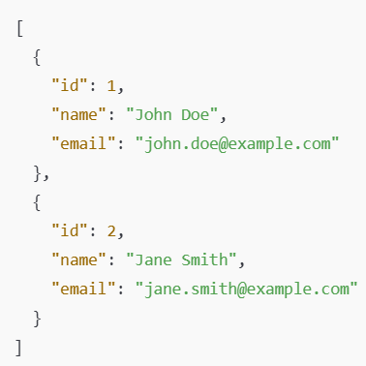
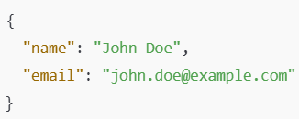
REST APIs and CRUD Operations
1. Create (POST): The POST method is used to create new resources on the server.
When sending a POST request, the client sends the data to be created in the body of the request.
Example:
You want to create a new user in a database.
Request: POST /users
2. Read (GET): The GET method is used to retrieve resources.
It can be used to fetch a list of resources or a specific resource by its identifier.
Example:
You want to fetch all users or a single user by their ID.
Request: GET /users (Fetch all users)

Slide 5
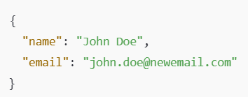
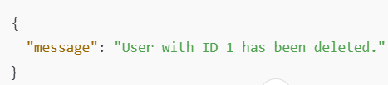
REST APIs and CRUD Operations
3. Update (PUT/PATCH): The PUT method is used to update an entire resource,
while PATCH can be used to update only specific fields of a resource.
Example:
You want to update a user's email.
Request: PUT /users/1
4. Delete (DELETE): The DELETE method is used to remove a resource from the server.
Example:
You want to delete a user with a specific ID.
Request: DELETE /users/1
4.

Slide 6
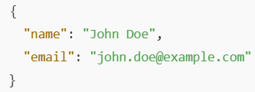
POSTMAN IMPLEMENTATION
Postman is a popular tool for testing APIs. You can use it to send HTTP requests to your Flask API and examine the responses.
Setting up Postman for Testing REST APIs:
Install Postman: Download and install Postman from Postman's official site.
Create a New Request: Open Postman, click on "New" -> "Request", and name the request. You'll then be able to configure the HTTP method, URL, and body for your requests.
Testing API Endpoints in Postman:
Create a New User (POST Request):
URL: http://127.0.0.1:5000/users
Method: POST
Get a User by ID (GET Request):
URL: http://127.0.0.1:5000/users/1
Method: GET
Hit Send and observe the response for user with ID 1.
Update a User (PUT Request):
URL: http://127.0.0.1:5000/users/1
Method: PUT
Get All Users (GET Request):
URL: http://127.0.0.1:5000/users
Method: GET
Hit Send and observe the list of users returned.
Delete a User (DELETE Request):
URL: http://127.0.0.1:5000/users/1
Method: DELETE
Hit Send and observe the confirmation message.
4.

Slide 7
Structuring APIs in Flask

Slide 8

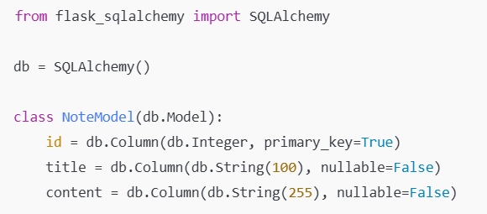
Flask Libraries
Flask SQLAlchemy
SQLAlchemy is a popular ORM (Object-Relational Mapping) library that allows you to interact with databases using Python objects instead of writing raw SQL queries. Flask-SQLAlchemy integrates SQLAlchemy with Flask, making it easier to work with databases.
Main functionality:
Database integration: Allows Flask to work with relational databases like MySQL, PostgreSQL, SQLite, etc.
Model creation: You define Python classes as models that represent your database tables.
Querying: You can perform database operations (CRUD - Create, Read, Update, Delete) using Python objects instead of raw SQL.
Session management: It handles database connections and sessions for you.

Slide 9

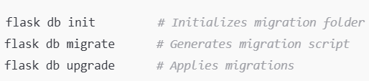
Flask Libraries
Flask-Migrate
Flask-Migrate is an extension that handles database migrations using Alembic. This allows you to track changes to your database schema and apply changes incrementally without losing data.
Main functionality:
Database migrations: When you change your models (e.g., adding new fields or tables), Flask-Migrate helps you apply those changes to your database schema.
Versioning: It keeps track of migration versions and allows you to roll back or apply specific migrations.
Command-line integration: It integrates with Flask’s command-line interface (flask db commands) to manage migrations easily.

Slide 10

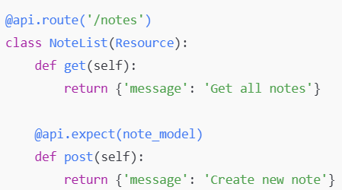
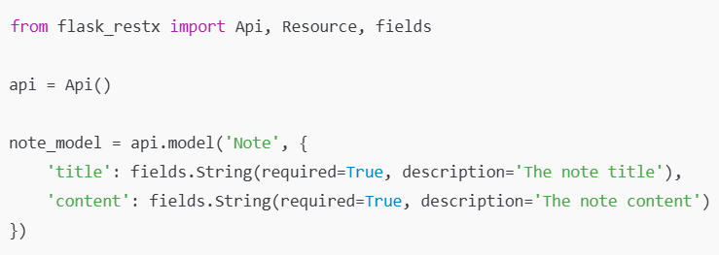
Flask Libraries
Flask-RESTx
Flask-RESTx is an extension for building RESTful APIs. It simplifies the process of creating APIs by providing tools to define routes, request/response formats, and more. It’s an extended version of Flask-RESTful and adds features like Swagger UI integration for API documentation.
Main functionality:
API route handling: It helps define API endpoints using classes and methods.
Swagger documentation: Automatically generates API documentation in Swagger UI, making it easier to interact with and test your APIs.
Request parsing and validation: Allows you to validate incoming requests, including JSON, form data, etc.

Slide 11

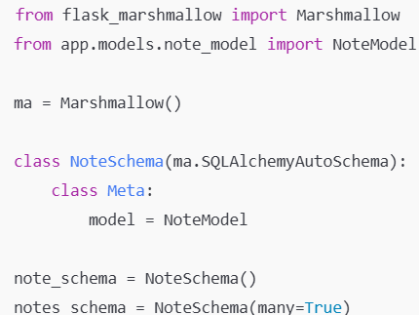
Flask Libraries
Flask-Marshmallow
Flask-Marshmallow integrates Marshmallow (a popular data serialization/deserialization library) with Flask. It helps in transforming complex data types, such as ORM models, into JSON format and vice versa. It is particularly useful when working with APIs to ensure that data is returned in the correct format.
Main functionality:
Serialization: Converts Python objects (like SQLAlchemy models) into JSON responses.
Deserialization: Converts incoming JSON data into Python objects (e.g., for creating new database records).
Schema validation: Validates input data against the schema to ensure it follows the expected format.

Slide 12

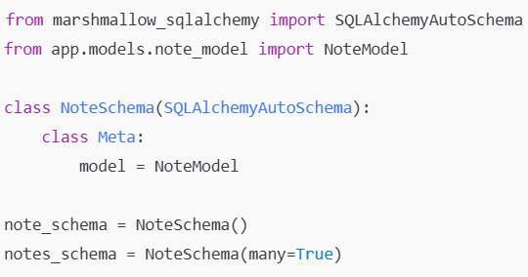
Flask Libraries
Marshmallow-SQLAlchemy
This library extends Marshmallow to support SQLAlchemy models directly. It allows automatic serialization and deserialization of SQLAlchemy models, which eliminates the need for custom field definitions.
Main functionality:
Auto-schemas: Automatically generates Marshmallow schemas for SQLAlchemy models.
Nested objects: Supports nested schemas when dealing with relationships between models (e.g., one-to-many or many-to-one).
Simplifies JSON parsing: Automatically handles many-to-many, one-to-many relationships between models.

Slide 13
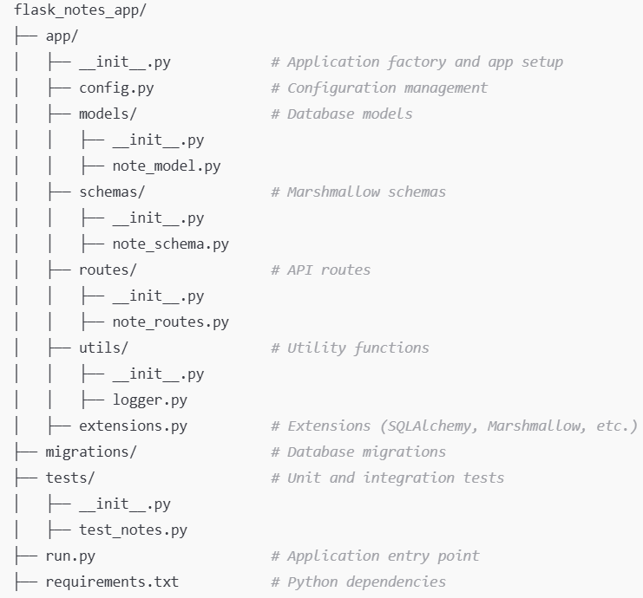
Structuring APIs in Flask
The notes API is designed to handle a simple system for managing notes. This could be used in a variety of applications where users need to create, store, retrieve, and delete notes. For example, it could serve as the backend for a note-taking application where users can store and manage personal notes.
Create a new note: Users can send a POST request with note data (such as a title and content) to create a new note.
Get all notes: Users can retrieve a list of all stored notes with a GET request.
Get a single note by ID: Users can retrieve a specific note by its ID using a GET request.
Delete a note by ID: Users can delete a note by its ID with a DELETE request.
Core Components in the Notes API
Model (Database):
NoteModel: This represents a note in the database, containing attributes like title and content.
The model is connected to a SQL database using SQLAlchemy.

Slide 14
Structuring APIs in Flask
Schema (Serialization):
NoteSchema: This schema handles the serialization and deserialization of note data. It is powered by Marshmallow,
which converts complex data types (like SQLAlchemy models) into native Python data types (such as dictionaries).
Routes:
/notes: Handles two HTTP methods:
GET: Fetches all notes from the database.
POST: Accepts JSON data to create a new note in the database.
/notes/<int:id>: Handles operations on a single note:
GET: Retrieves a note by its ID.
DELETE: Deletes a note by its ID.
Swagger Documentation:
The Flask-RESTX library is used to create an API with automatic documentation through Swagger.
This allows users and developers to view and interact with the API via a user-friendly web interface at /swagger.
Blueprints in Flask allow you to structure your application in a modular way. Instead of placing all the routes, models, and configurations in a single file (such as app.py), you can split them into smaller, reusable components called blueprints. Each blueprint handles a specific functionality or section of your application.

Slide 15

Structuring APIs in Flask
Blueprint Creation: A blueprint named note_bp is created in the app/routes/note_routes.py file.
Routes Defined: All routes related to notes (e.g., GET /notes, POST /note) are defined within this blueprint.
Registering Blueprint: In the main app file (app/__init__.py), the blueprint is registered using app.register_blueprint(note_bp, url_prefix='/api'). This allows the routes to be grouped under /api.

Slide 16
Thank You!

